Slide 1

Task-based programming in COMPSs to converge from HPC to Big Data
Rosa M Badia Barcelona Supercomputing Center
CCDSC 2016, La Maison des Contes, 3-6 October 2016

Slide 2
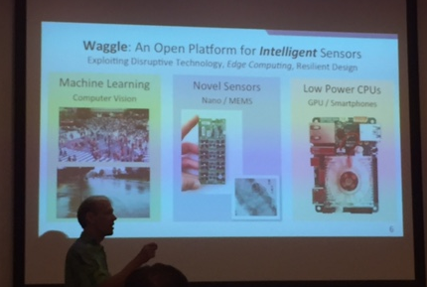
Challenges for this talk at CCDSC 2016
Challenge #1: how to “uncan” my talk to meet the expectations of the workshop
Challenge #2: how to make an interesting talk in the morning … after the first visit to the cave
Challenge #3: how to speak after Pete and keep your interest

Slide 3
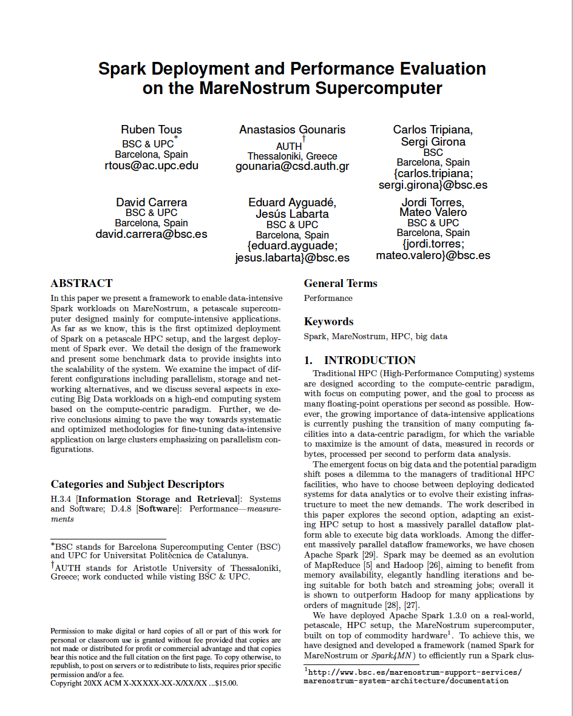

Goal of the presentation
Why we do not compare Spark to PyCOMPSs?

Slide 4
Outline
COMPSs vs Spark
Architecture
Programming
Runtime
MN deployment
Codes and results
Examples: Wordcount, Kmeans, Terasort
Programming differences
Some performance numbers
Conclusions

Slide 5
COMPSs vs Spark

Slide 6
Architecture comparison

Slide 7
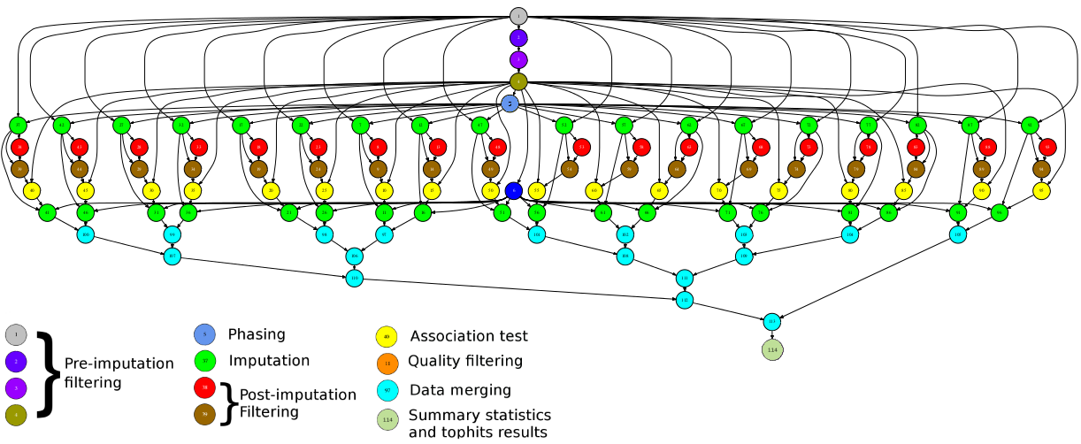

Programming with PyCOMPSs/COMPSs
Sequential programming
General purpose programming language + annotations/hints
To identify tasks and directionality of data
Task based: task is the unit of work
Simple linear address space
Builds a task graph at runtime that express potential concurrency
Implicit workflow
Exploitation of parallelism
… and of distant parallelism
Agnostic of computing platform
Enabled by the runtime for clusters, clouds and grids
Cloud federation

Slide 8
Programming with Spark
Sequential programming
General purpose programming language + operators
Main abstraction: Resilient Distributed Dataset (RDD)
Collection of read-only elements partitioned across the nodes of the cluster that can be operated on in parallel
Operators transform RDDs
Transformations
Actions
Simple linear address space
Builds a DAG of operators applied to the RDDs
Somehow agnostic of computing platform
Enabled by the runtime for clusters and clouds

Slide 9

COMPSs Runtime behavior
User code + task annotations
Grids
Clusters
Clouds
TDG
Tasks
Files, objects
Runtime

Slide 10
Spark runtime
Runtime generates a DAG derived from the transformations and actions
RDD is partitioned in chunks and each transformation/action will be applied to each chunk
Chunks mapped in different workers – possibility of replication
Tasks scheduled where the data resides
RDDs are best suited for applications that apply the same operation to all elements of a dataset
Less suitable for applications that make asynchronous fine-grained updates to shared state
Intermediate RDD can persist in-memory
Lazy execution:
Actions trigger the execution of a pipeline of transformations

Slide 11
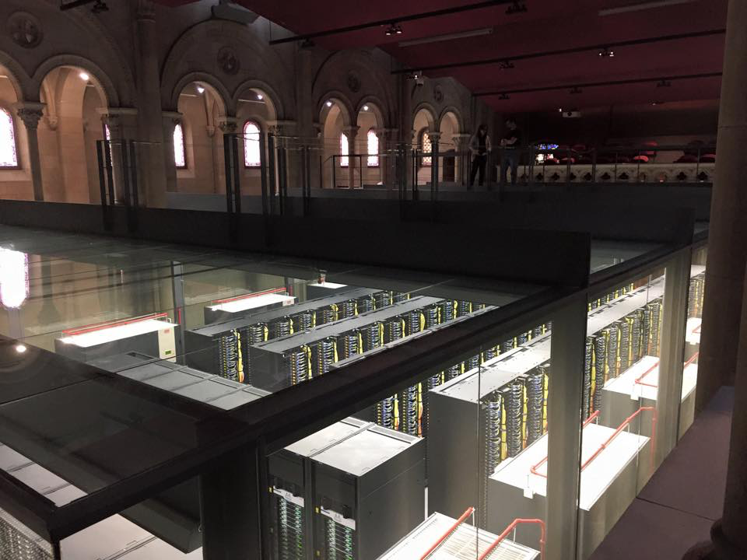
COMPSs @ MN
MareNostrum version
Specific script to generate LSF scripts and submit them to the scheduler: enqueue_compss
N+1 MareNostrum nodes are allocated
One node runs the runtime, N nodes run worker processes
Each worker process can execute up to 16 simultaneous tasks
Files in GPFS
No data transfers
Temporal files created in local disks
Results from COMPSs release 2.0 beta
To be released at SC16

Slide 12
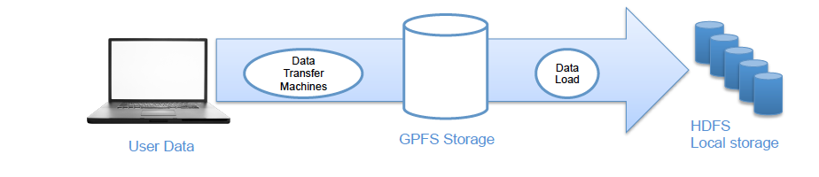
SPARK @ MN - spark4mn
Spark deployed in MareNostrum supercomputer
Spark jobs are deployed as LSF jobs
HDFS mapped in GPFS storage
Spark runs in the allocation
Set of commands and templates
Spark4mn
sets up the cluster, and launches applications, everything as one job.
spark4mn_benchmark
N jobs
spark4mn_plot
metrics

Slide 13
Codes and results

Slide 14
Codes
Three examples from Big Data workloads
Wordcount
K-means
Terasort
Programming language
Scala for Spark
Java for COMPSs
… since Python was not available in the MN Spark installation

Slide 15


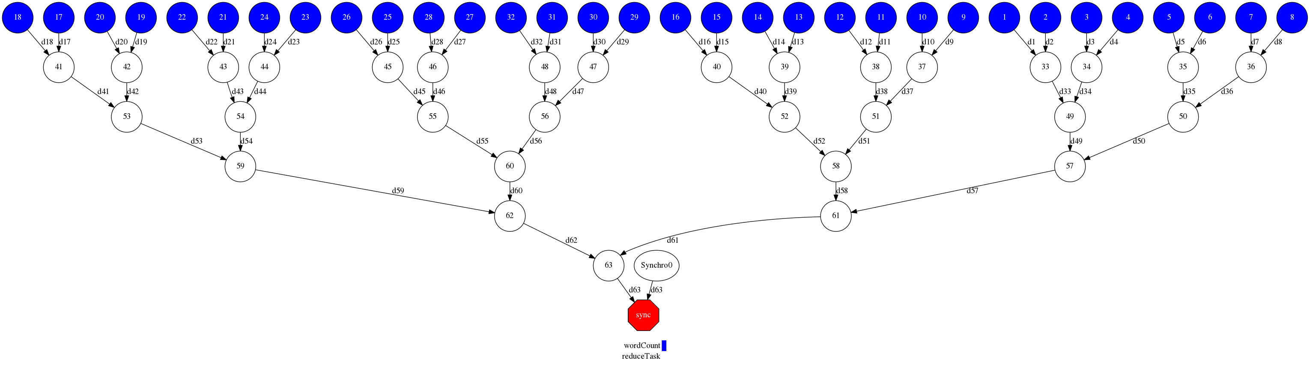
Code comparison – WordCount (Scala/Java)
JavaRDD<String> file = sc.textFile(inputDirPath+"/*.txt");
JavaRDD<String> words = file.flatMap(new FlatMapFunction<String, String>() {
public Iterable<String> call(String s) {
return Arrays.asList(s.split(" "));
}
});
JavaPairRDD<String, Integer>
pairs = words.mapToPair(new PairFunction<String, String, Integer>() {
public Tuple2<String, Integer> call(String s) {
return new Tuple2<String, Integer>(s, 1);
}
});
JavaPairRDD<String, Integer>
counts = pairs.reduceByKey(new Function2<Integer, Integer, Integer>() {
public Integer call(Integer a, Integer b) {
return a + b;
}
});
counts.saveAsTextFile(outputDirPath);
int l = filePaths.length;
for (int i = 0; i < l; ++i) {
String fp = filePaths[i];
partialResult[i] = wordCount(fp);
}
int neighbor=1;
while (neighbor<l){
for (int result=0; result<l; result+=2*neighbor){
if (result+neighbor < l){
partialResult[result] = reduceTask (partialResult[result],
partialResult[result+neighbor]);
}
}
neighbor*=2;
}
int elems = saveAsFile(partialResult[0]);
public interface WordcountItf {
@Method (declaringClass = "wordcount.multipleFilesNTimesFine.Wordcount")
public HashMap<String, Integer> reduceTask(
@Parameter HashMap<String, Integer> m1,
@Parameter HashMap<String, Integer> m2 );
@Method (declaringClass = "wordcount.multipleFilesNTimesFine.Wordcount")
public HashMap<String, Integer> wordCount(
@Parameter (type = Type.FILE, direction = Direction.IN) String filePath );}
Notes:
TextFile creates RDD file with content of the file
flatMap ~ map -> separates all words of the file
mapToPair – maps each word with the value 1
reduceByKey – accumulates values with the same key

Slide 16
Code comparison – WordCount (Python)
from __future__ import print_function
import sys
from operator import add
from pyspark import SparkContext
if __name__ == "__main__":
if len(sys.argv) != 2:
print("Usage: wordcount <file>", file=sys.stderr)
exit(-1)
sc = SparkContext(appName="PythonWordCount")
lines = sc.textFile(sys.argv[1], 1)
counts = lines.flatMap(lambda x: x.split(' ')) \
.map(lambda x: (x, 1)) \
.reduceByKey(add)
output = counts.collect()
for (word, count) in output:
print("%s: %i" % (word, count))
sc.stop()
from collections import defaultdict
import sys
if __name__ == "__main__":
from pycompss.api.api import compss_wait_on
pathFile = sys.argv[1]
sizeBlock = int(sys.argv[2])
result=defaultdict(int)
for block in read_file_by_block(pathFile, sizeBlock):
presult = word_count(block)
reduce_count(result, presult)
output = compss_wait_on(result)
for (word, count) in output:
print("%s: %i" % (word, count))
@task(returns=dict)
def word_count(collection):
result = defaultdict(int)
for word in collection:
result[word] += 1
return result
@task(dict_1=INOUT)
def reduce_count(dict_1, dict_2):
for k, v in dict_2.iteritems():
dict_1[k] += v
Notes:
def read_word(file_object):
for line in file_object:
for word in line.split():
yield word
def read_file_by_block(fp,sizeBlock):
"""Lazy function (generator) to read a file piece by piece in chunks of size approx sizeBlock"""
data = open(fp)
block = []
for word in read_word(data):
block.append(word)
if sys.getsizeof(block) > sizeBlock:
yield block
block = []
if block:
yield block

Slide 17
Kmeans – code structure
Algorithm based on the Kmeans scala code available at MLlib
COMPSs code written in Java, following same structure
Input: N points x M dimensions, to be clustered in K centers
Randomly generated
Split in fragments
Iterative process until convergence:
For each fragment: Assign points to closest center
Compute new centers

Slide 18
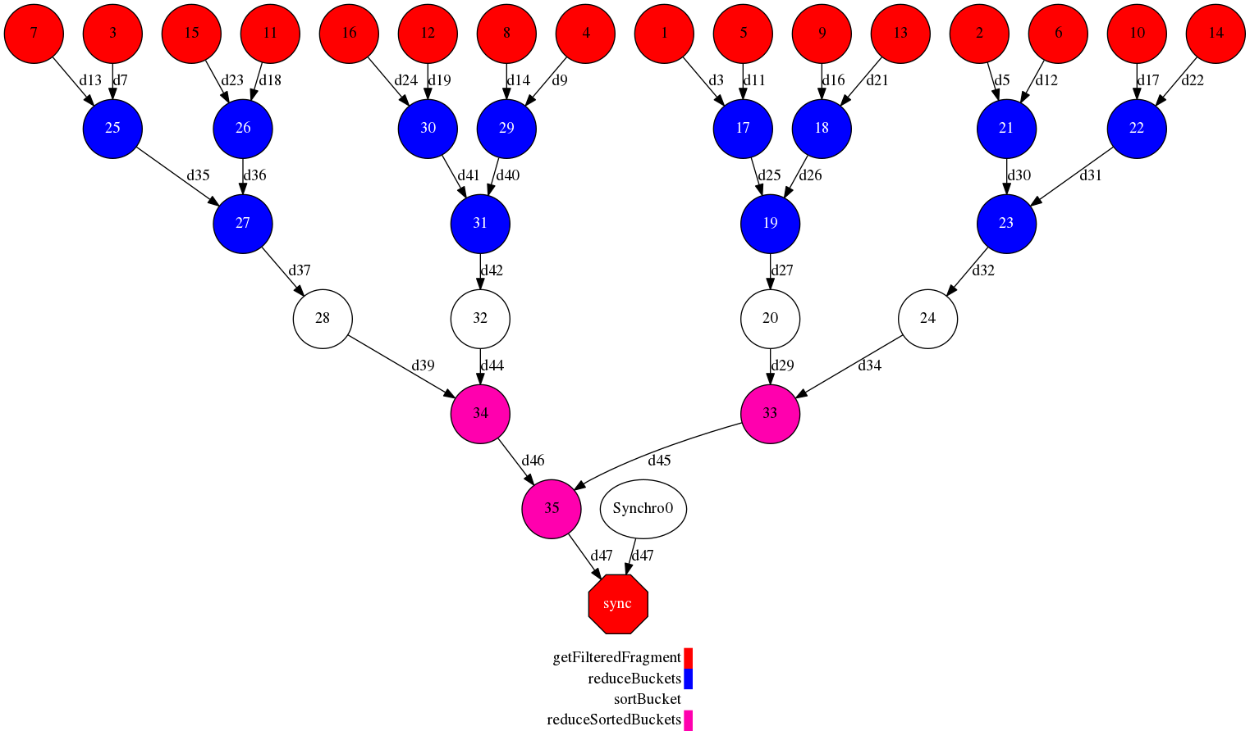
Terasort
Algorithm based on the Terasort scala code available at github by Ewan Higgs
COMPSs code written in Java, following same structure
Data partitioned in fragments
Points in a range are filtered from each fragment
All the points in a range are then sorted

Slide 19
Code comparison
 | WordCount |  | Kmeans |  | Terasort
 | COMPSs | Spark | COMPSs | Spark | COMPSs | Spark
Total #lines | 152 | 46 | 538 | 871 | 542 | 259
#lines tasks | 35 |  | 56 |  | 44
#lines interface | 20 |  | 35 |  | 34
#tasks / #operators | 2 | 5 | 4 | 12 | 4 | 4
Spark codes more compact
Less flexible interface

Slide 20
WordCount performance
Strong scaling
1024 files / 1GB each = 1TB
Each worker node runs up to 16 tasks in parallel
Weak scaling
1 GB / task

Slide 21
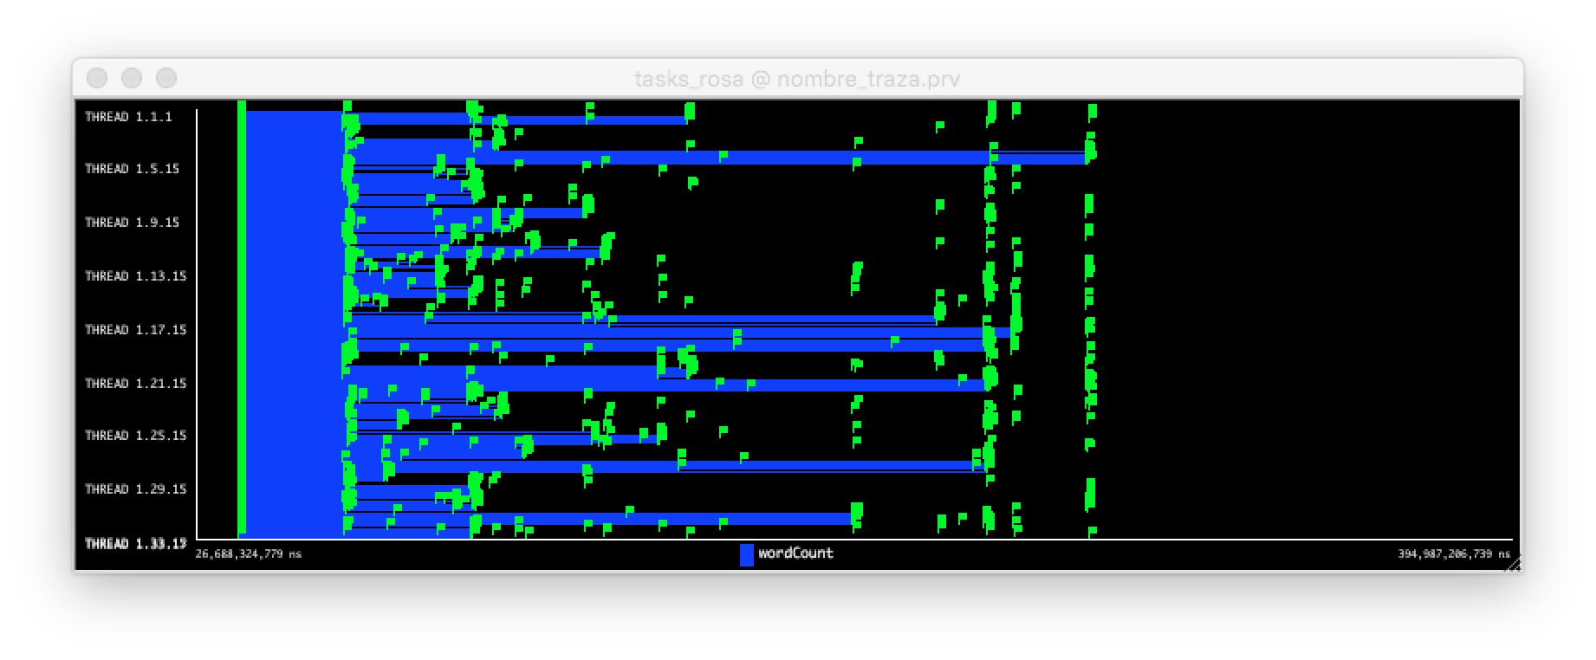
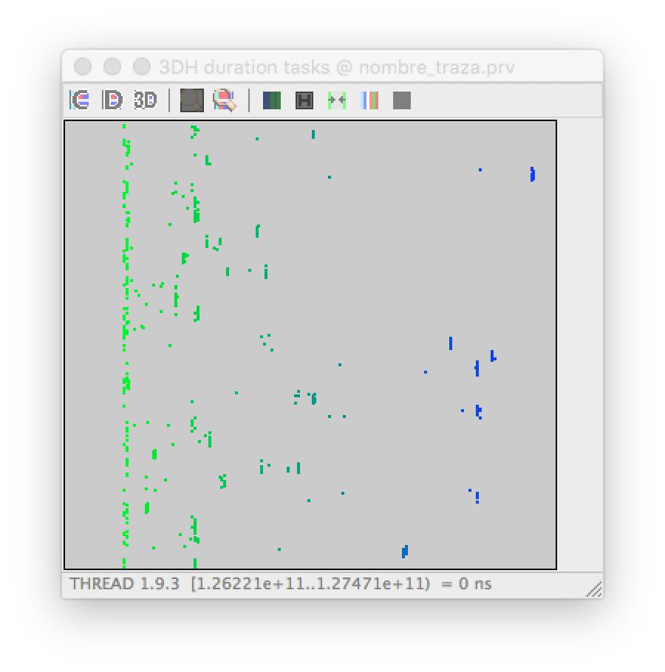
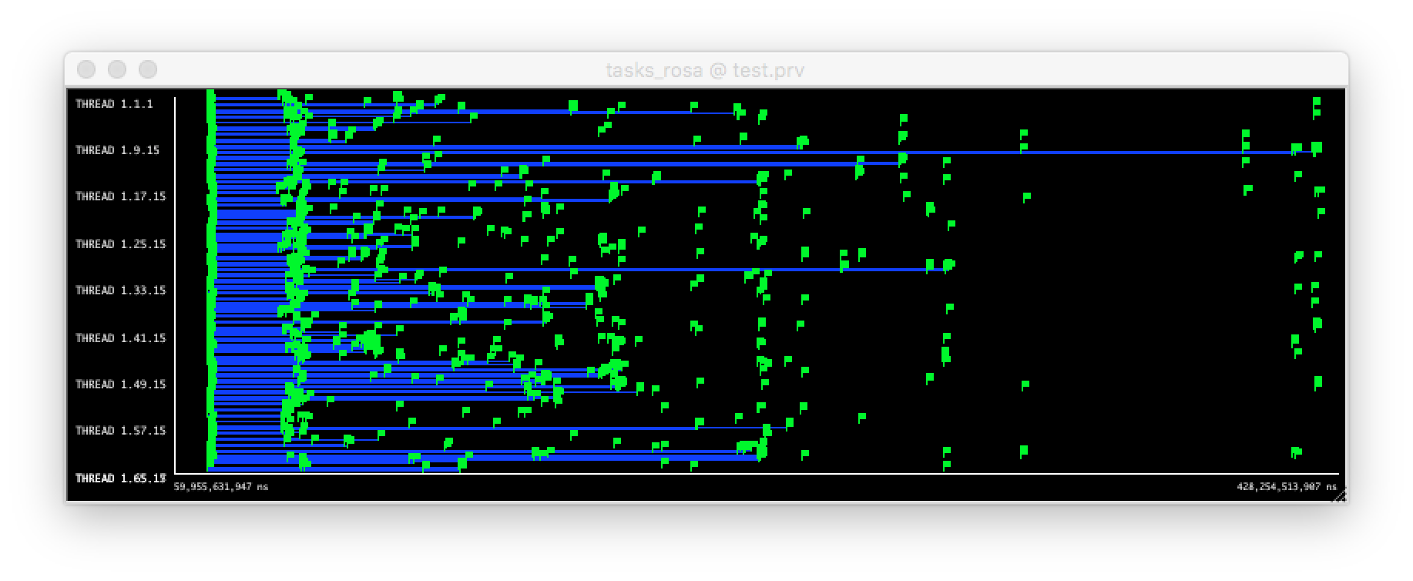
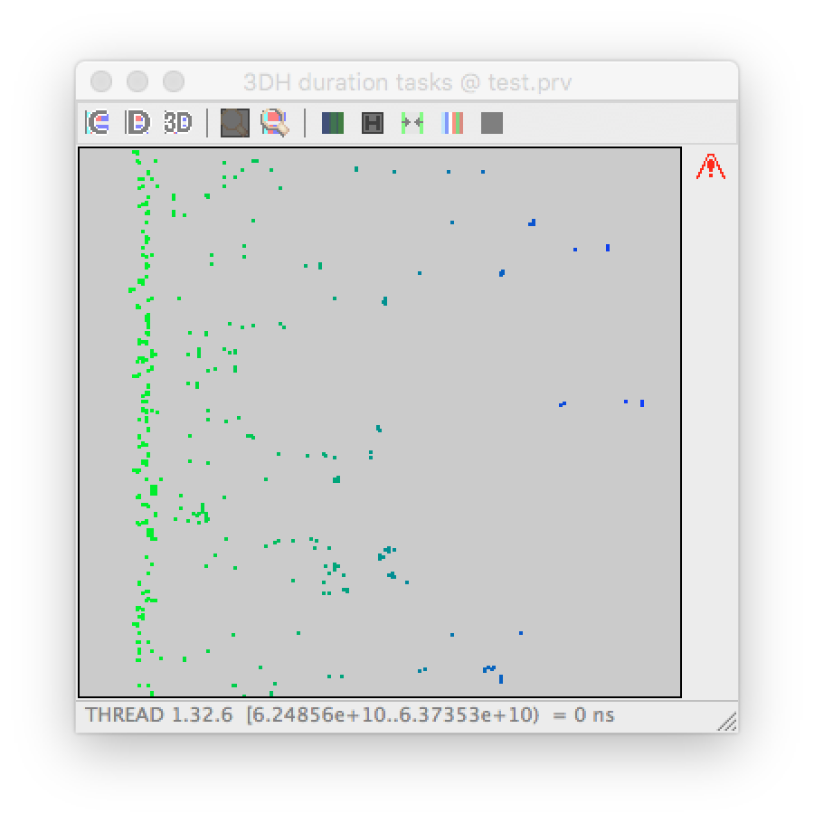
WordCount traces - strong scaling
Large variability due to reads to gpfs
32 nodes
64 nodes

Slide 22
Kmeans performance
Strong scaling – total dataset:
Points 131.072,000
Dimensions 100
Centers 1000
Iterations 10
Fragments 1024
Total dataset size: ~100 GB
Weak Scaling – dataset per worker:
Points 2.048,000
Dimensions 100
Centers 1000
Iterations 10
Fragments 16
Dataset size: ~1.5 GB

Slide 23
Terasort performance
Strong Scaling
256 files / 1 GB each
Total size 256 GB
Weak scaling
4 files / 1 GB per worker
4 GB / worker

Slide 24
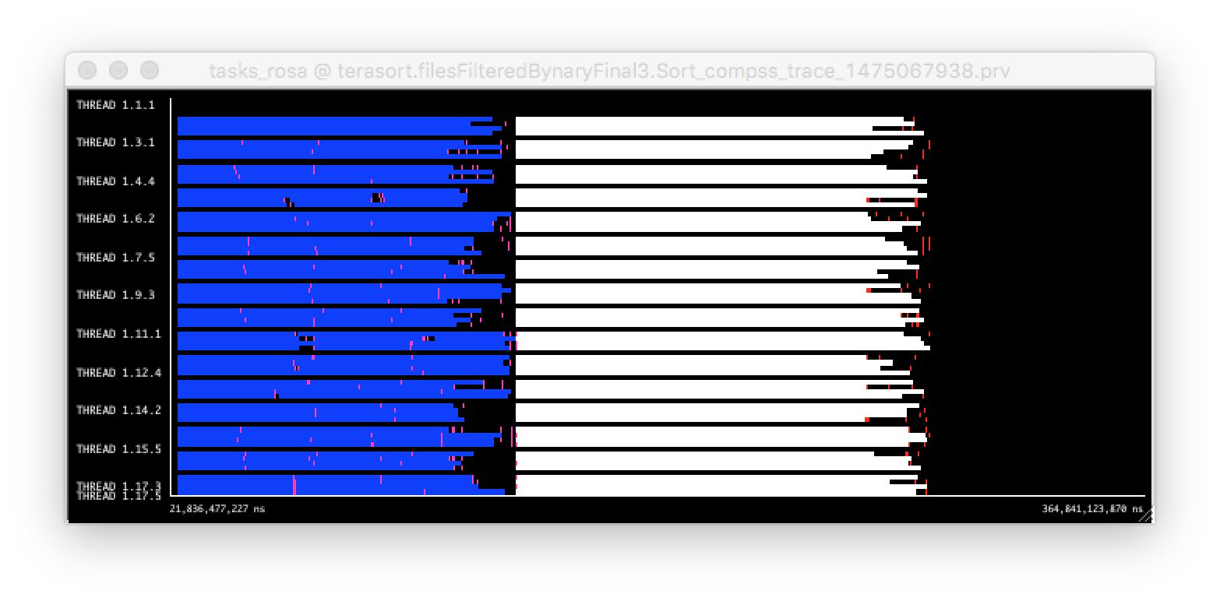
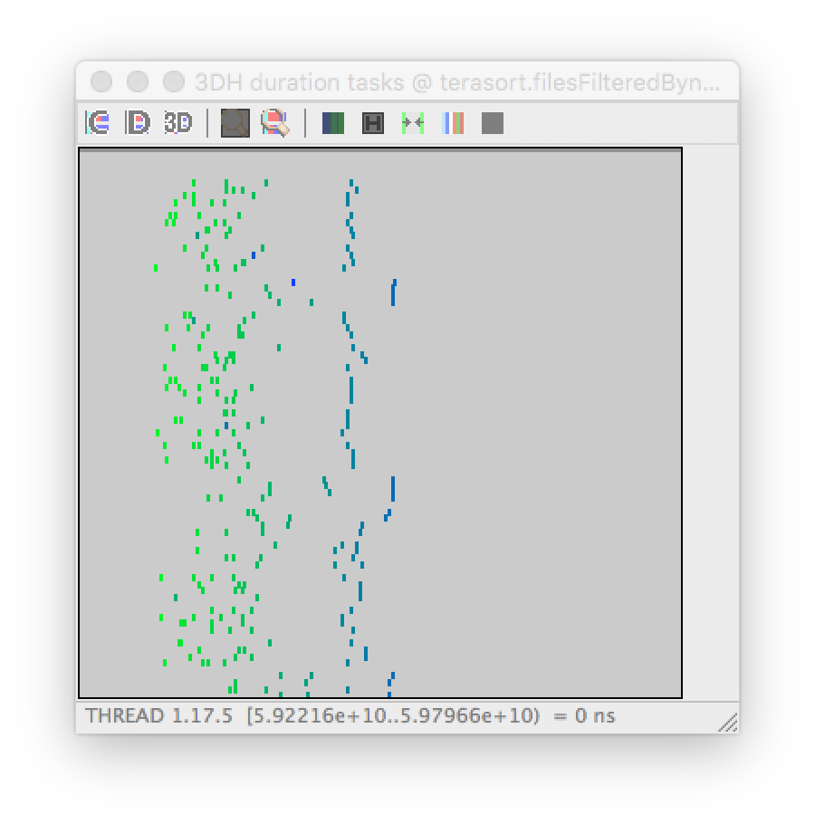
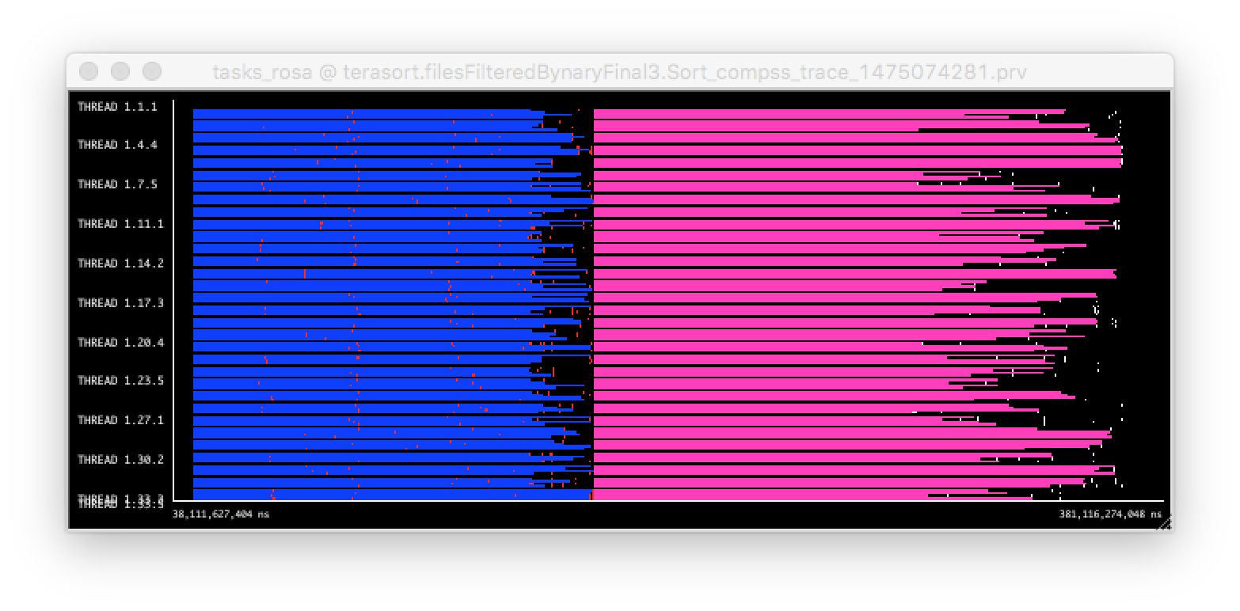
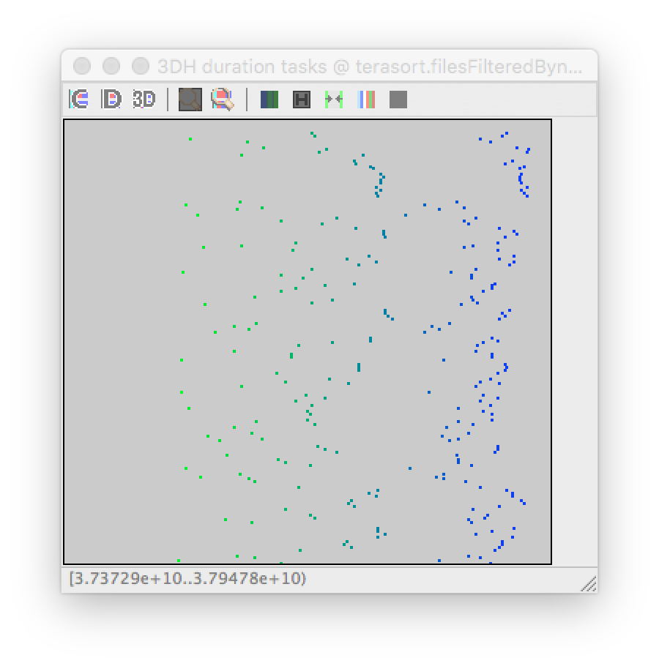
Terasort traces – weak scaling
16 nodes
32 nodes
Sort task duration increases significantly
+ large variability
Reads/writes from file

Slide 25
Conclusions
Summary of comparison
Spark code is more compact
COMPSs offers more flexibility, both in programming model and runtime behavior
Performance results slightly better for COMPSs
Need to better understand reasons for better performance
Ongoing work:
Integration with new storage technologies:
dataClay, Hecuba
Will improve current issues with traditional file systems (gpfs)
Support to end-to-end HPC workflows
COMPSs runtime enabled to run MPI workloads as tasks
Support for streaming
Future plans
Promotion of PyCOMPSs in Python community
Enablement of automatic installation (pip install)
Distribution
compss.bsc.es

Slide 26

Maybe we will not kill the giant…
…but we will try hard

Slide 27
Thank you!

